Slide 1
COVID-19 INDIA ANALYSIS

Slide 2


TABLE OF CONTENTS
Presentation Outline
Project Recap
The Analytical Team
Process
Insights
Challenges Faced
Learnings
Summary

Slide 3

PROJECT
RECAP
The problem we are addressing with this project is to analyze and gain insights from the COVID-19 data in India. The COVID-19 pandemic has had a profound impact on public health, and understanding the data is crucial for decision-making and resource allocation. Our goal is to provide valuable insights and create a data-driven dashboard to aid in understanding the pandemic's progression and its effects on different regions of India.

Slide 4





THE ANALYTICAL TEAM
Fardin Khan
Vanshpal Singh
Sachin Yadav
Vishwanath J

Slide 5
PROCESS
1
Data Understanding & Execution Plan
2
Data Extraction and Processing
3
Creating Necessary Aggregated Tables
4
Analysis & Dashboard Creation
5
Inights Gathering
6
Last Day Quality Assurance

Slide 6


Slide 7


Total Tested
1,13,068M
Total Confirmed
7,263M
Total Recovered
6,843M
Total Deceased
97M

Slide 8

Confirm To Test Ratio
6.4%
Recover To Confirm
94.2%
Death To Confirm
1.3%

Slide 9
CASES BY CATEGORIES
Categories Based on Test Ratio
Highest Confirmed Cases
Lowest Confirmed Case
A: >=0.05 & <=0.1
B: >01 & <=0.3
C: >0.3 & <=0.5
D: >0.5 & <=0.75
E: >0.75 & <=1.0
B: 11.6M
E: 0.1M
Highest Deaths Contribution
Lowest Death Contribution
B: 62%
E: 0.3%
Test Ratio = number of tests done / population

Slide 10
WORST DECEASED & CONFIRM
Worst State
Worst District
Confirmed :
Maharashtra
Confirmed :
Bangaluru
Deceased :
Maharashtra
Deceased :
Bangaluru
District
Safest State
Safest District
Confirmed :
Lakshadweep
Confirmed :
Dibrugarh
Deceased :
Dadra Nagar Haveli and Daman and Diu
Deceased :
Dibrugarh

Slide 11



WEEKLY TREND
1
2
3
4
5
1
2
3
4
5
1
2
3
4
5
Confirmed
Recovered
Deceased
In every month, confirmed, Recovered, and Deceased cases suddenly Drops in 5 the week.

Slide 12
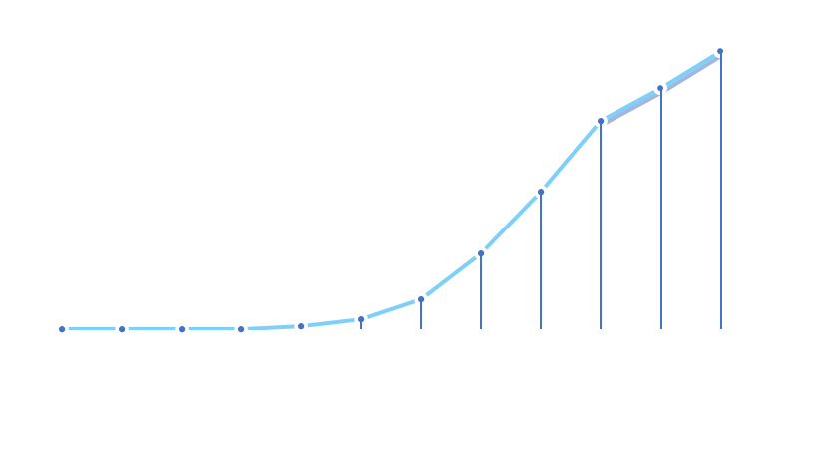
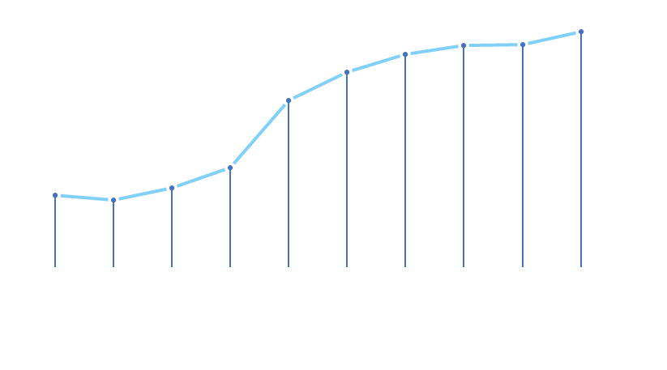
MONTHLY TREND
2020
2021
669M
<400M
<1M
3M
May
May
In every Year, confirmed cases Exponentially increases in May.

Slide 13
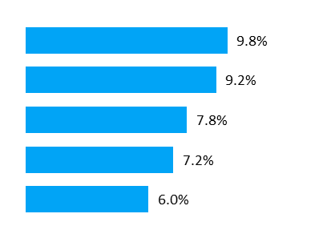
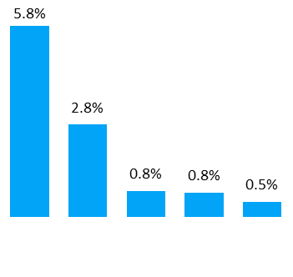
D7 CONFIRMED CASES
Even After vaccination
Top 5 District
Top 5 States
Idukki
Pathanamthitta
Kozikode
Thiruvananthapuram
Thrissur
Kerala
Ladakh
Poducherry
Himachal
Pradesh
Nagaland

Slide 14
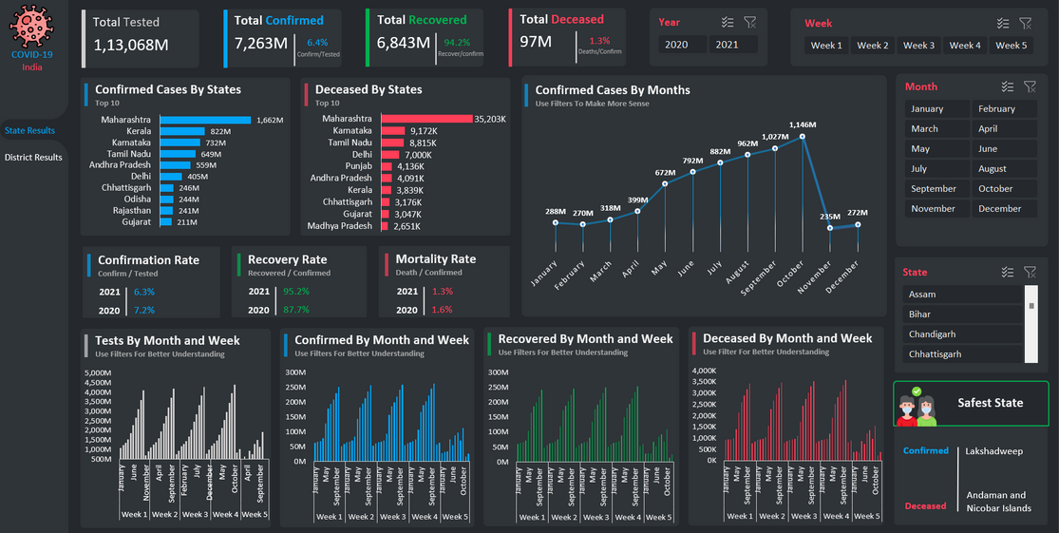
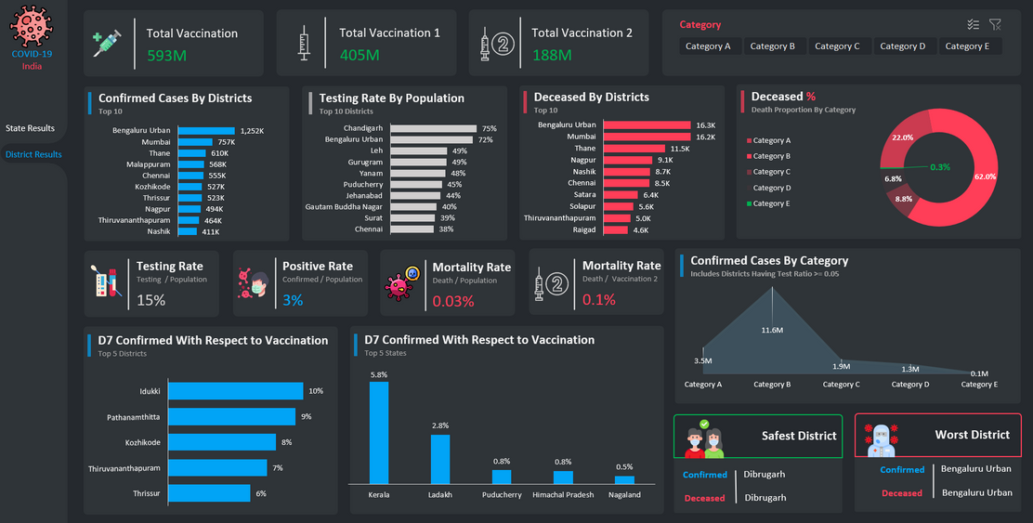

DASHBOARD

Slide 15

CHALLENGES FACED
Data Extraction: We initially faced difficulties in getting data from the server, but we persevered and figured it out.
Data Cleanup: Dealing with messy data, including missing values and confusing entries, was a challenge. We brainstormed and tried different methods to clean it up and make it useful.
Data Visualization: Visualizing the data in a way that answered the project's questions was tough. We had to think creatively and work as a team to present the data effectively.
Time Management: Meeting project deadlines required good time management skills, and we learned to prioritize tasks efficiently.

Slide 16

LEARNINGS
Persistence: We learned to keep trying when faced with data extraction problems.
Data Cleaning: We improved our skills in making messy data useful through experimentation.
Creative Problem-Solving: We found creative ways to visualize complex data through teamwork.
Teamwork and Communication: Working with diverse viewpoints improved our communication and collaboration skills.
Time Management: Efficiently managing our time became crucial to meet project deadlines.

Slide 17
SUMMARY
In conclusion, our analysis of the COVID-19 situation in India has yielded valuable insights and actionable information for understanding and managing the pandemic. Through meticulous data preparation, rigorous SQL-based aggregations, and thoughtful Excel-based reporting, we have achieved the following:
Weekly Evolution.
Testing Ratios (tr)
Delta7 vs. Vaccination
Severity KPIs
Worst Month Analysis
Finally, an Interactive Dashboard which is can be utilized for quick insights gathering, which gives 360 views if filters are utilized.

Slide 18
THANK YOU!
Any Questions?

